Slide 1
Going Beyond ReSharper with Roslyn

Slide 2
Agenda
Background and Getting Started
Syntax Visualizer
Code Refactoring
Code Analyzers
Unit Testing Analyzers
Tips & Gotchas
Questions & Discussion

Slide 3
Disclaimer
All Material Is Subject To Change If/When Released
Based on Visual Studio 2015 CTP 6

Slide 4






About Me – Jason Lattimer
Sr. CRM Consultant – PowerObjects
Microsoft MVP – Dynamics CRM
@JLattimer
jlattimer.blogspot.com
github.com/jlattimer
codeplex.com/site/users/view/JLattimer

Slide 5
What is “Roslyn”?
.NET Compiler Platform
Was C++ Now C#/VB.NET
Access the Same APIs for Code Analysis and Refactoring

Slide 6
Getting Started
https://github.com/dotnet/roslyn
Latest CTP (6) Versions:
Visual Studio 2015 – Link
Visual Studio 2015 SDK – Link
SDK Templates – Link
Syntax Visualizer – Link
Azure VM Available

Slide 7
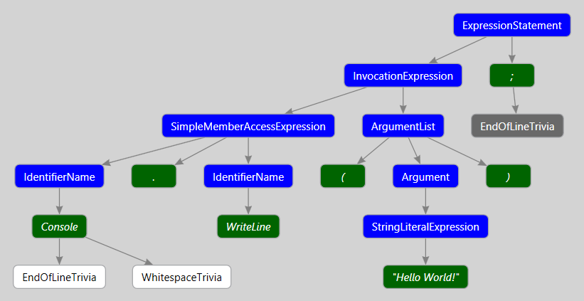
Syntax Visualizer
Console.WriteLine("Hello World!");
Notes:
SyntaxVisualizerExample

Slide 8
Code Refactoring
Examples
Roslyn Template
Formatting XML
Multiple Refactorings
Notes:
BaseCodeRefactoringExample – XmlRefactoring - MultiRefactoring

Slide 9
Code Analyzers
Examples
Roslyn Template
Code Block
Syntax
Notes:
BaseAnalyzerExample – BlockAnalyzer - SyntaxAnalyzer

Slide 10
Unit Testing Analyzers
Unit Test Format
Verbatim String Literal vs. StringBuilder
Full Namespaces Or Add Reference in DiagnosticVerifier.Helper.cs
Notes:
SyntaxAnalyzer.Test

Slide 11
Deployment
Vsix – Global Across Visual Studio
NuGet – Installed Per project & included in Source Control
Manual – Installed Per project & included in Source Control
Create Custom Code Analysis Rule Set – Include In TFS Check-in Policy
Notes:
CheckInPolicyAnalyzerExample - AnalysisConsoleExample

Slide 12
Tip - Replace the Simplest Piece of Syntax
account1["Name"] = "test1";
String Only
Versus
Brackets & String
http://roslynquoter.azurewebsites.net/
https://github.com/KirillOsenkov/RoslynQuoter

Slide 13
Tip – Group Analyzers By name

Slide 14
Gotchas
Beware Of Outdated Web Content
Uninstall Other Test Extensions
Reset Experimental & Roslyn Visual Studio Instances
Change Vsix Version
Close Test Application Before Debugging (CTP?)
Log Out/In Normal & Experimental Visual Studio Instances (CTP?)
NuGet Bug Going From CTP5 to CTP 6
Refactoring Project Targets Wrong Version of .NET Framework (CTP?)

Slide 15
Questions/Comments
Where might you use custom code analysis or refactorings in your personal or business development?
Sample Code & Slides
github.com/jlattimer/GoingBeyondReSharperWithRoslyn_Demo

